Slide 1

Employee Management System
Presented By:
Akanksha. A
Neeraja. D
Vishnu Priya.G

Slide 2
Agenda
Objective of the Project
Problem Statement
ER Diagram
Schema explanation
Key analysis questions (use cases)
SQL query results with screenshots or summaries
Final business insights
Recommendations for Business
Conclusion (Key finding overall)
Q&A Slide
Challenges working on SQL – Data Analysis Project.

Slide 3
OBJECTIVE OF THE PROJECT
The main goals of this SQL project are:
● To design and implement a relational database for Employee Management System.
● To retrieve and manipulate data using SQL queries.
●The system helps maintain employee details, job roles, qualifications, leaves, and payroll information
●The project also provides useful insights for HR through SQL queries such as salary analysis, leave patterns, and departmental performance.

Slide 4
PROBLEM STATEMENT
The objective of this project is to design and implement an Employee Management System that efficiently stores and manages employee-related data within an organization. The system needs to track various aspects of employee information, including personal details, job roles, salary structures, qualifications, leave records, and payroll data. The system should ensure the integrity and consistency of data by using relational tables with appropriate foreign keys and cascading actions.

Slide 5
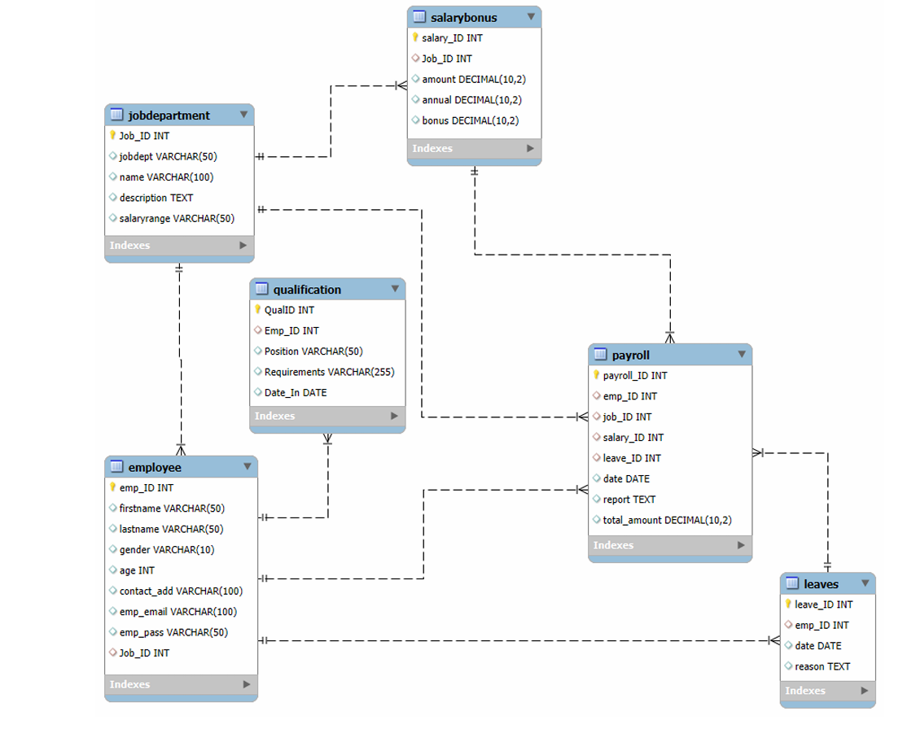
ENTITY- RELATIONSHIP DIAGRAM

Slide 6
SCHEMA EXPLANATION
The schema of the Employee Management System organizes and connects employee-related data in the database.
It includes tables such as Employee, JobDepartment, SalaryBonus, Payroll, Qualification, and Leaves.
Employees are linked to job roles using Job_ID, and payroll, qualifications, and leaves connect through Emp_ID.
Salary structures are defined through the SalaryBonus table linked to JobDepartment.
These relationships help manage employee information, salary processing, and leave tracking efficiently.

Slide 7

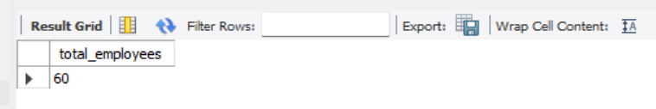
EMPLOYEE INSIGHTS
1. How many unique employees are currently in the system?
Output :

Slide 8
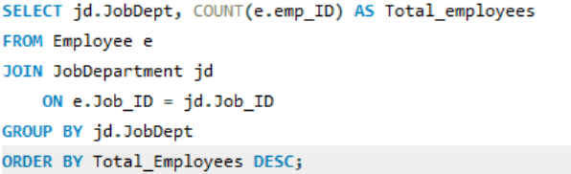
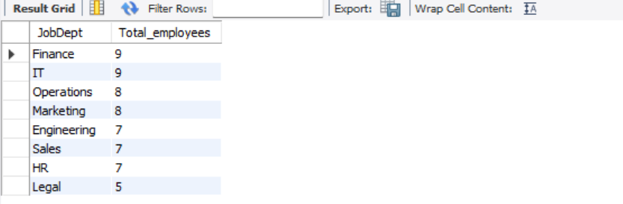
2. Which departments have the highest number of employees?
Output :

Slide 9
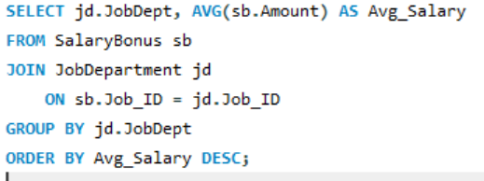
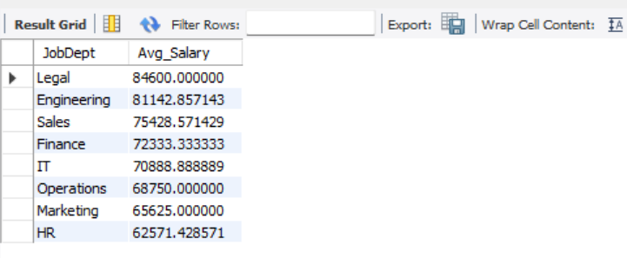
3. What is the average salary per department?
Output :

Slide 10
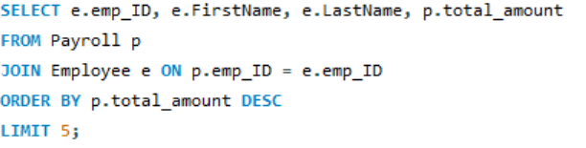
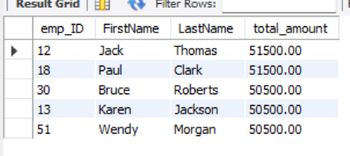
4. Who are the top 5 highest-paid employees?
Output :

Slide 11


5. What is the total salary expenditure across the company?
Output :

Slide 12
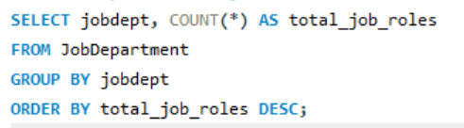
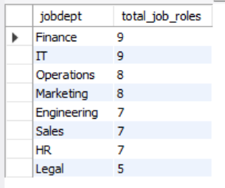
JOB ROLE AND DEPARTMENT ANALYSIS
1. How many different job roles exist in each department?
Output :

Slide 13
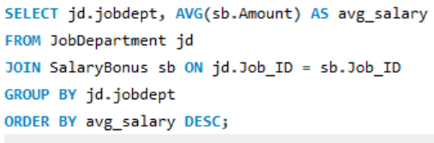
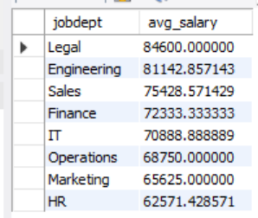
2. What is the average salary range per department?
Output :

Slide 14
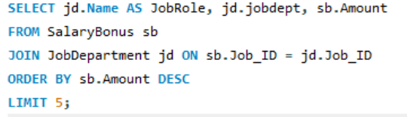
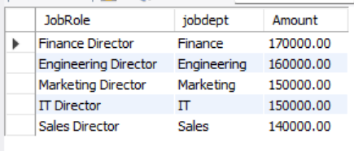
3. Which job roles offer the highest salary?
Output :

Slide 15
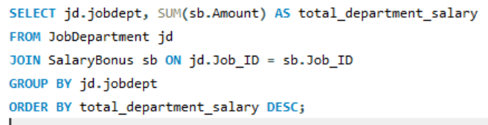
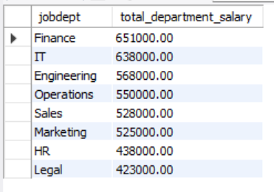
4. Which departments have the highest total salary allocation?
Output :

Slide 16


QUALIFICATION AND SKILLS ANALYSIS
1. How many employees have at least one qualification listed?
Output :

Slide 17
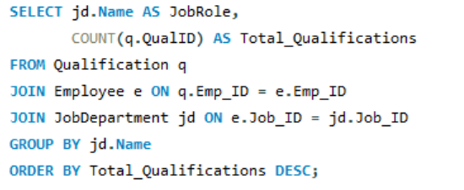
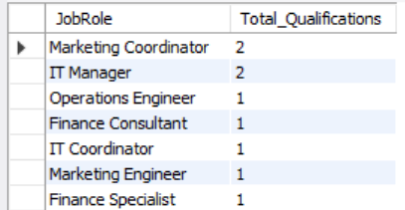
2. which positions require the most qualifications?
Output :

Slide 18
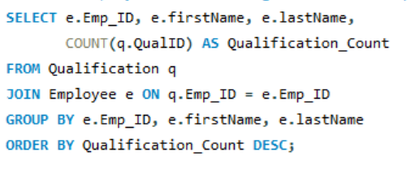
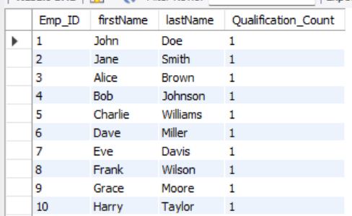
3. Which employees have the highest number of qualifications?
Output :

Slide 19
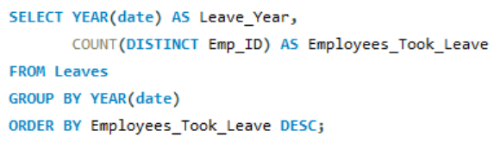

LEAVE AND ABSENCE PATTERNS
1. Which year had the most employees taking leaves?
Output :

Slide 20
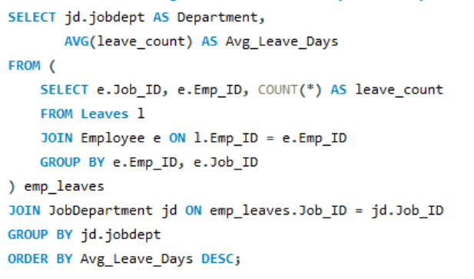
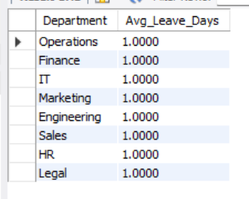
2. What is the average number of leave days taken by its employees per department?
Output :

Slide 21
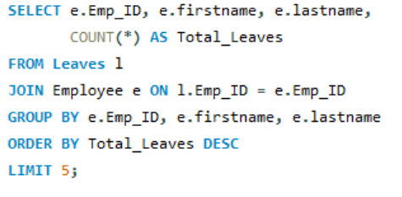
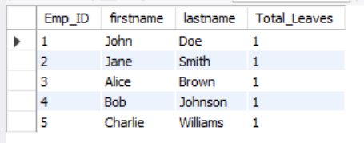
3. Which employees have taken the most leaves?
Output :

Slide 22


4. What is the total number of leave days taken company-wide?
Output :

Slide 23
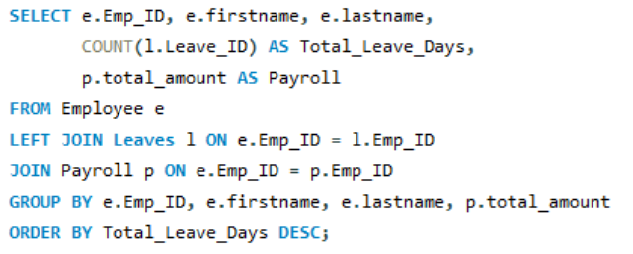
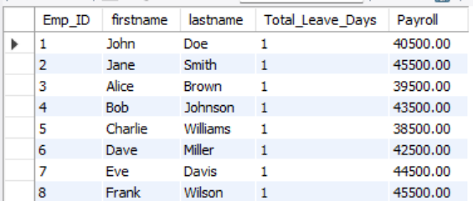
5. How do leave days correlate with payroll amounts?
Output :

Slide 24


PAYROLL AND COMPENSATION ANALYSIS
1. What is the total monthly payroll processed?
Output :

Slide 25
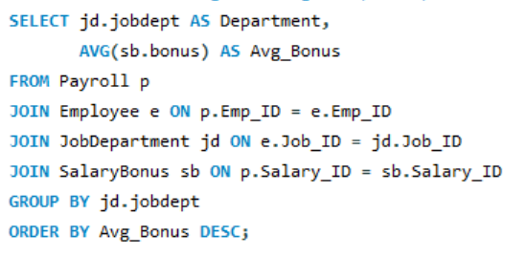
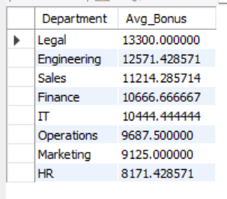
2. What is the average bonus given per department?
Output :

Slide 26
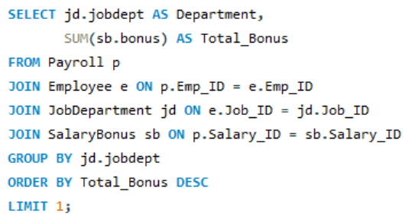

3. Which department receives the highest total bonuses?
Output :

Slide 27
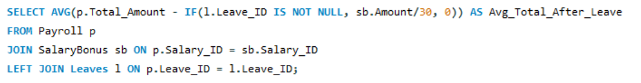

4. What is the average value of total_amount after considering leave deductions?
Output :

Slide 28
BUSINESS INSIGHTS
Improved Workforce Planning
Higher Productivity through Role Alignment
Effective Payroll & Budget Management
Stronger Talent & Skill Development
Better Leave & Attendance Monitoring
Data-Driven HR Decisions

Slide 29
RECOMMENDATIONS FOR BUSINESS
Optimize Workforce Allocation – Ensure the right staffing levels in each department based on skills and workload.
Align Roles with Skills – Assign employees to roles that match their qualifications to boost productivity.
Manage Payroll & Budget – Monitor salaries, bonuses, and leave deductions to control costs efficiently.
Invest in Employee Development – Identify skill gaps and provide targeted training programs.
Enhance Data-Driven HR Decisions – Use centralized employee data for hiring, promotions, attendance, and performance management.

Slide 30
CONCLUSION
The Employee Management System centralizes employee data for efficient HR management. It streamlines payroll, leave tracking, and role assignments while supporting data-driven decisions. The system enhances productivity, transparency, and overall organizational efficiency.

Slide 31
CHALLENGES WORKING ON SQL-DATA ANALYSIS PROJECT
Writing complex queries with joins was a bit tricky.
Sometimes queries took longer, so I had to optimize them.
Maintaining data accuracy with keys and constraints was important.
Converting query results into meaningful insights was challenging.

Slide 32
THANK YOU

